Slide 1


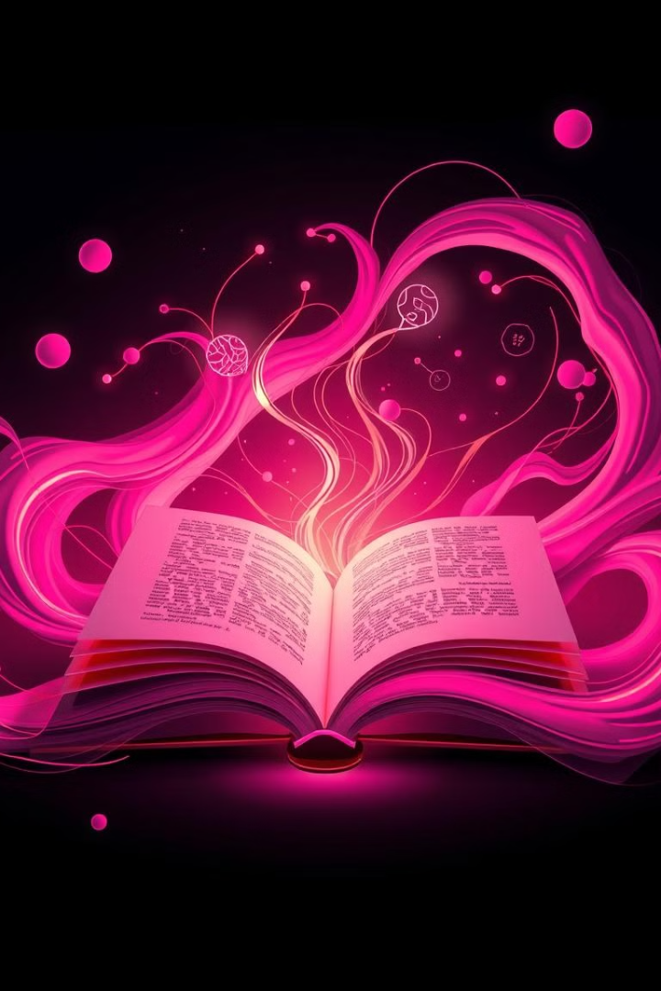



Generative Narrative
Literature Review & Progress
Presented by Team 1 (Supriyo Pal, Trina Chowdhury, Hadiya Mushtaq, Sahil Jayprakash Singh, Riket Ram Bhosale)
Project Mentor(s)
Ishpreet Kaur & Kuljeet Singh
17-09-2024

Slide 2
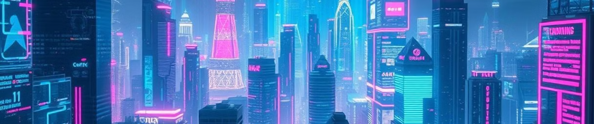
Introduction
Project Overview
The focus of this project is to explore how generative models, particularly in the field of AI, can create coherent narratives. This involves both text generation (e.g., narrative from visual data) and prompt optimization for narrative quality.

Slide 3


Project objectives
Analyze the techniques behind narrative generation using AI models.
1
2
Identify the challenges in creating coherent stories across different input modalities (e.g., text-to-image).
3
Review existing tools and techniques in the literature.
4
Implement and evaluate generative models capable of storytelling.

Slide 4


Key research findings on the topic
01
02
03
Literature review-
Key Technique
Gaps identified
Visual Storytelling (Research Paper 3):
By embedding both visual and text data into a common semantic space, visual coherence in storytelling improves.
Prompt Optimization in Text-to-Image Generation (Research Paper 4):
Optimized prompts produce more aesthetically pleasing and contextually relevant narratives.
Storytelling AI System (Research Paper 1):
The combination of text generation, text-to-image synthesis, and style transfer creates an interactive storytelling experience​.
Visual Storytelling :
Bidirectional Attention-based RNN (BARNN) models generate coherent paragraphs from image sequences​(research paper 5).
Prompt Optimization in Text-to-Image Generation :
Reinforcement learning refines user input to improve the alignment of text-to-image models with user goals​(research paper 4).
Storytelling AI System :
This system generates short stories with complementary images using minimal user input. It integrates a GPT-2 model for text generation, BigGAN for image generation, and CycleGAN for neural style transfer​(research paper 1).
Existing models for generative narratives often struggle with long-term coherence across multiple data inputs (e.g., visual sequences or long text). (research paper 2) There is limited integration of feedback mechanisms like reinforcement learning to adapt model performance for specific narrative outcomes. While semantic embedding has been explored for visual storytelling, more research is needed on how to seamlessly integrate multiple modalities (e.g., sound, image, and text) into one narrative generation model. (research paper 5)

Slide 5
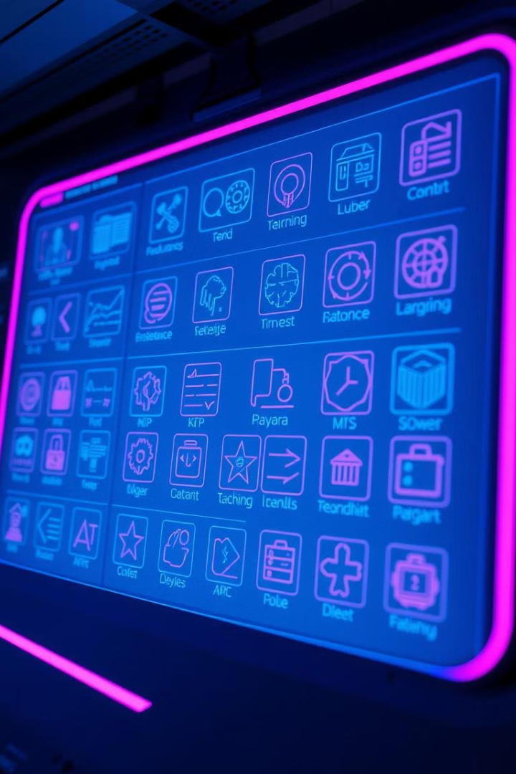
Techniques and Tools from Literature
Semantic Embedding and Recurrent Models
Techniques such as embedding images and corresponding text into a common semantic space to reduce variance across photo streams. (research paper 5)
Reinforcement Learning
Adaptive techniques like Promptist, which modify input prompts for enhanced text-to-image generation, improving narrative aesthetics​. (research paper 1)
GAN (Generative Adversarial Networks) based models or Diffusion Models
GPT-4 for generating the text-based narrative and DALL-E for creating images based on the chapters or scenes described in the story. They use a combination of GANs or Diffusion Models to generate high-quality images from descriptive text. (research paper 1).

Slide 6
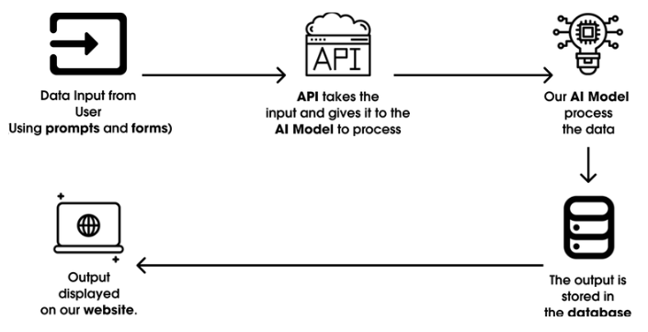


Project Progress So Far
Initial Findings
Generative models can effectively produce narrative sequences, but coherence over long sequences remains challenging. Reinforcement learning has proven effective in improving narrative quality by optimizing prompts, especially in text-to-image applications.
Completed Tasks
Review of current literature on generative storytelling.

Slide 7
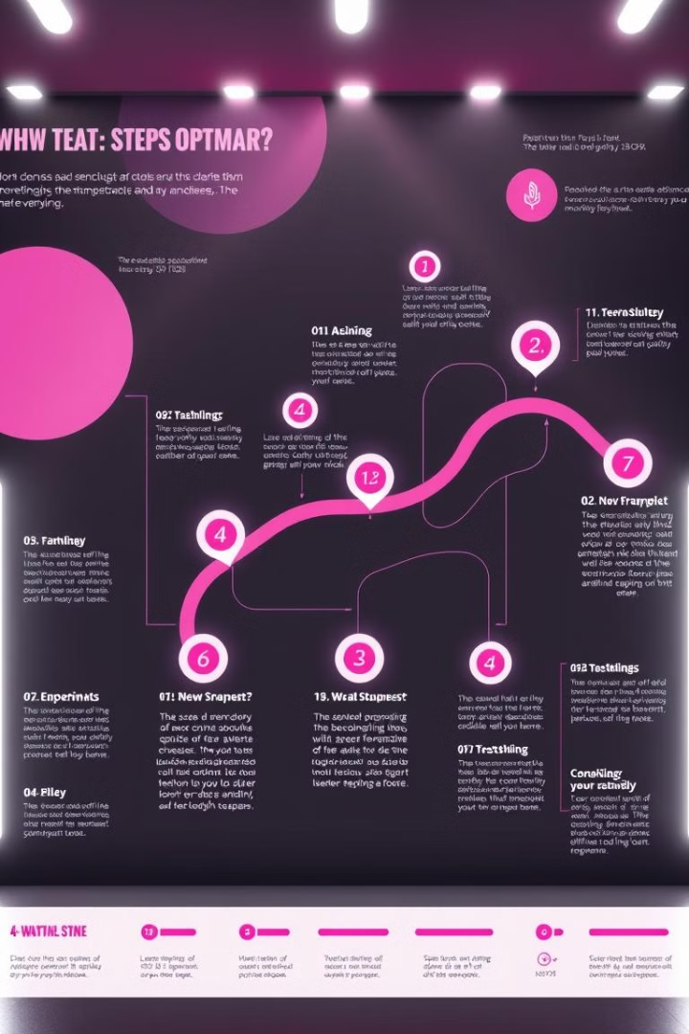


Next Steps
Immediate Goals
Implement a combined model that integrates image and text inputs into a seamless narrative. Test different prompt adaptation techniques to refine narrative coherence.
Long-Term Plans
Explore multi-modal generative narratives that include sound, image, and text. Refine generative models using user feedback and reinforcement learning.

Slide 8

Thank you

